Slide 1
European sports clusters go international

Slide 2
Who we are?

Slide 3
Which are our objectives?
One of the main aims of the project is to foster the internationalization of European firms, which still depend largely on their domestic markets despite the opportunities offered by globalization at large
BENEFITS: Evidences prove the direct link between internationalization and increased SME performance:
Being internationally active correlates strongly with higher turnover growth
SMEs that are internationally active generally report higher employment growth
The relationship between internationalization and innovation is strong
Despite evidences of the positive impact of internationalization activities, only 25% of EU based SMEs had been involved in exports (inside Europe and beyond) in the three previous years and that only 13% targeted markets outside the EU.

Slide 4
Basic Information
Budget: 600.000€ (EU Funding 450.000€)
Duration: 2 years (2016 – 2017)
5 project partners (823 members)
Coordinator:

Slide 5
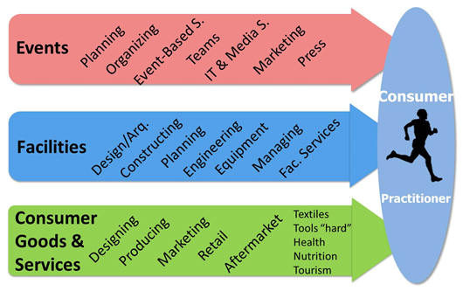
The alliance approach (i)
Definition of the sports industry as:
One final consumer (sports practitioner)
3 main value chains

Slide 6
The alliance approach (ii)
List Of Internationalization Activities
Fact-finding actions in destination markets
Explore the feasibility of establishing ESSCP ambassadors abroad
Internationalization Standard Actions in 2 target markets: China and USA
Action in the third market (Iran) will take place on a later stage, proving the continuity of the Alliance beyond EU funding).
Launch of Joint Internationalization Groups
Reverse missions to Europe
Explore the feasibility of a ESSCP Permanent Representation in Europe
Assistance to 2 Cluster to Cluster Matchmaking events
Guide on EU funding for sports industry 2014-2020
Training sessions about alternative funding

Slide 7
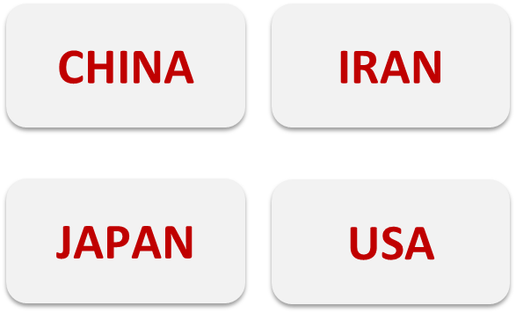
Joint Internationalization Strategy
Standard Actions abroad. Trade Missions
Target Markets
Knowledge from EU4SportsClusters (2012)
EU4SC ALLIANCE Priorities (2016)

Slide 8
Joint Internationalization Strategy
IRAN
Market Potential:
Second largest economy in the Middle East
Second largest population in the region. 78,8 million (2015). Two thirds of population are under 30ç
Fourth largest oil reserves, second largest stock of natural gas
Public commitment with sport infrastructures, to develop tourism industry
Government of President Rohani has simplified the entry system
End November, early December 2016
Target Groups:
Facility planners and consultants
Swimming pool constructors
Equipment Manufacturers
Facility management
Product groups:
Design, architecture, engineering
Access and software control
Fan engagement (football)
Sky related products
Accommodations

Slide 9
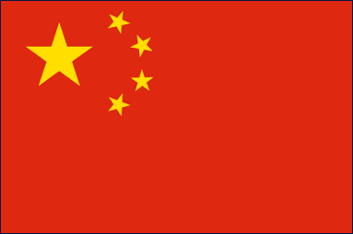
Joint Internationalization Strategy
CHINA
Market Potential:
Second largest economy in the world
Largest population in the world, 1.370 million (2015)
Tree main areas of interest: Beijing, Shanghai and Sichuan (outdoor practice and facilities)
Governmental strategy on winter sports (2022 winter Olympic Games – Beijing)
Beijing - Mid February 2017
Categories:
Fitness growing very fast
Running
Basketball (must-cover team sport)
Outdoor (x 3 in last 5 years)
Action sports (not yet, potential)
Sports apparel and footwear (consolidated)

Slide 10
Joint Internationalization Strategy
5 Joint Internationalization Groups (JIGs) – Export Groups
EU as a destination
Attract people outside the EU to European sports facilities, events and infrastructure (service oriented)
China
The triathlon Tech platform
Create high added value products for swimming, cycling and running (through aerodynamics, hydrodynamics, smart products, sport field labs..)
China + Taiwan, South Korea, Japan
Winter sport events
Export the event approach to other countries: the organization of (worldwide) sport events (engineering, facilities, security, etc.)
China
Smart sport parks in public spaces
Making smart sports areas (in cities or in outdoor areas, like ski resorts) by using sensors, internet... to create interaction with the crowd
USA
(Japan, China)
Sport facilities sustainable in use
Make existing or new facilities sustainable in its use, either for high end (small market) or low end (large market) solutions
China
(USA, Canada, Japan)

Slide 11
Joint Internationalization Strategy
Joint Internationalization Groups (JIGs) – Export Groups

Slide 12
Joint Internationalization Strategy
Joint Internationalization Groups (JIGs)
Between 3-5 manufacturers or services
Member products are not competitive with each other
Not aimed to carry out an individual export action, but are usually part of a long term strategy
Sharing an Export Manager that will be paid by the companies that make up the JIG. Main tasks:
Identifying the most suitable market segment for the group
Identifying the most appropriate distribution channels
Knowing policies on products design, price, promotion and distribution in accordance with each company
Setting sales targets for each member of the group
Executing sales and sending the offers
Preparing promotion group promotion actions
Consolidating the position of each company in the target country
Regularly reporting to the companies

Slide 13
Thanks!!
Montse Centellas
mcentellas@indescat.org

