Slide 1
National Cluster Platform Austria
Dr. Stefan Buchinger, CSE
Head of Division Economic Policy and European Internal Market
Federal Ministry for Digital and Economic Affairs
Conference/Event: EU-Korea Cluster Cooperation Seminar and Matchmaking Event
Date: 07.11.2018
Place: Vienna

Slide 2
Agenda
General remarks about Clusters and Competitiveness
Facts and Figures about Clusters in Austria
Conclusions
2

Slide 3
1. General remarks about clusters
Clusters are strategic platforms promoting collaboration at different geographic levels (regional, national and beyond)
The overarching goal of clusters is to improve competitiveness
3

Slide 4
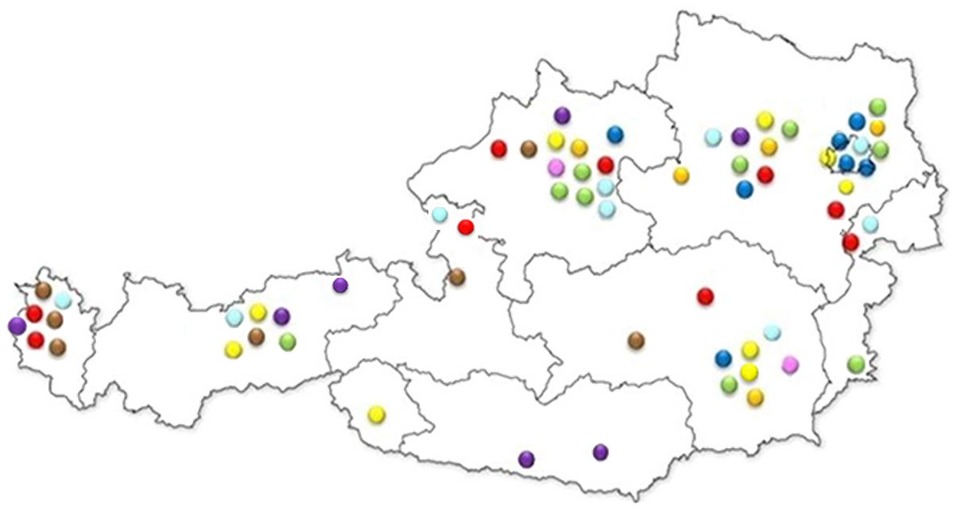
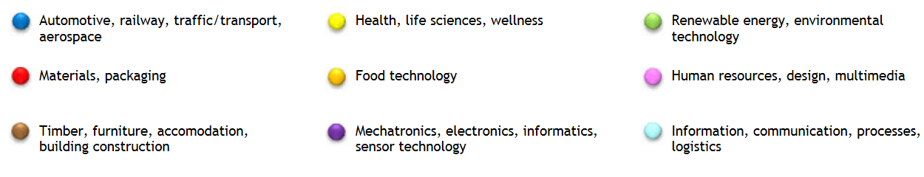
2. Facts and Figures
Fact box
> 60 clusters and networks
> 7.100 cluster members, 73 % SME
> 815.000 employees
58 % manufacturing companies
~ 600 R&D institutions
Ø 7,5 % R&D quota
50 % export quota
~ 300 international partnerships
4

Slide 5
Activities of clusters and networks
Communication activities and information for a diverse range of industries
Workforce training and know-how-transfer (events, workshops, exchange of best practice examples,...)
Innovative co-operation projects between enterprises and research facilities; specific funding instruments for co-operation projects
(Inter)national promotion of companies and clusters
5

Slide 6



Cluster landscape
DG GROW
Internal Market
Industry
Entrepreneurship
and
SMEs
National Cluster Platform
DG REGIO
Regional and
Urban
Policy
Cluster organisations in the Austrian regions
6

Slide 7






































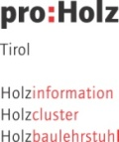


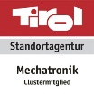




























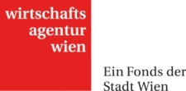









Austrian National Cluster Platform
Clusters and network-initiatives
Cluster organisations
Public institutions and agencies with a focus on RDTI and cluster activities
7

Slide 8
Activities of the National Cluster Platform
Austrian cluster conference
Working groups of the National Cluster Platform
Information about the Platform, especially website
Active participation in EU strategies and programmes
8

Slide 9
Austrian Cluster Working groups
Working Groups
Clusters and the national innovation system
Cluster practice in research, innovation and qualification
Cluster relevant developments in technology and innovation on the European level incl. regional policy
Internationalisation of clusters
Digitization, Industry 4.0 and innovative services
Environment and energy research
9

Slide 10
3. Conclusions
Clusters are strategic platforms
They promote collaboration and improve competitiveness
Currently they face new challenges and conditions
Internationalization highly important
The Austrian Ministry for Digital and Economic Affairs aims to:
  Harness and coordinate regional efforts
  Create linkages to European and international partners
10

Slide 11
Contact and Information
Dr. Stefan Buchinger, CSE
Head of Division Economic Policy and European Internal Market
Federal Ministry for Digital and Economic Affairs
stefan.buchinger@bmdw.gv.at
11

