Slide 1
Presentation of the German
Central Innovation Programme for SMEs (ZIM)
EU-Canada Cluster Cooperation Event
Hanover Fair – 1 April 2019
Carmen Heidecke
Head of Division Central Innovation Program for SME (ZIM)

Slide 2
From idea to market success - innovation programmes for SMEs
EXIST
Central Innovation Programme
INVEST
HTGF
Start-up Contest
go-Inno, go-digital
Digital Competence Centers for SME
IT-Security
go-cluster
Digital Hub Initiative
German Accelerator
Collective Industrial Research
INNO-KOM
WIPANO
Digital Technologies
Credits and Mezzanine
IGP/Non-technical Innovations
IDEA
MARKET
Start-up
Competence
Precompetitive
Close to market
Innovation-friendly framework conditions

Slide 3
Central Innovation Programme for SMEs (ZIM)
Largest programme supporting the innovative „Mittelstand“ (SME); Budget 555 mio € in 2019
More than 3.000 (sub-)projects per year
Growing number of international projects (about 5% of the cooperation projects)
Objective: Technology and sector open support for innovative SME (less than 500 employees)
Measure: Grants for innovative R&D projects and network management

Slide 4
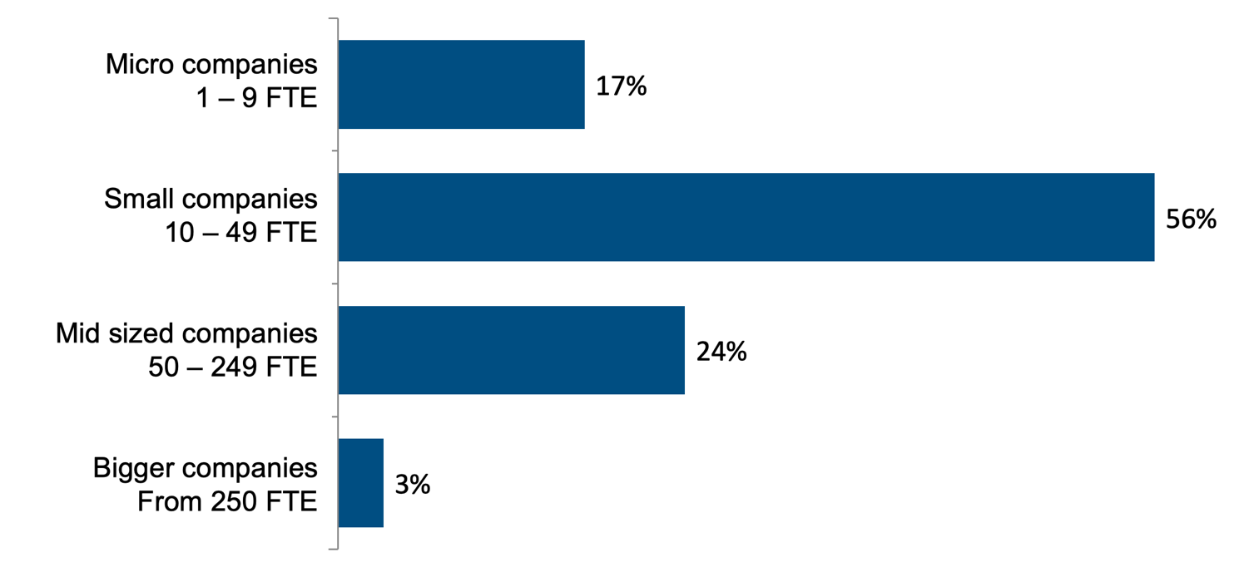
Funding by company size

Slide 5
ZIM – all under one roof
 | ZIM Individual projects | ZIM Cooperation projects | ZIM Innovation networks
Research & Development funding | R&D Individual projects in companies | R&D Cooperation projects between companies or companies and research and technology organizations | Cooperation networks Network management R&D Cooperation projects R&D Individual projects
 | additionally: innovation advisory services and innovation support services
Program Management | EuroNorm GmbH | AiF Projekt GmbH | VDI/VDE Innovation + Technik GmbH

Slide 6
Central Innovation Programme for SMEs (ZIM)
Eligible Volume: up to 380.000 € per (sub-)project and network management.
International network: up to 450.000 €
Rate of funding: 25-55% of eligible volume for companies, 100% R&D research institutes (up to 190.000 €).
International R&D project: up to 10%-points more
Declining funding of network management (90-50%) over the term of usually 1 + 2 years.
International network: 95-40%, usually 1,5 + 3 years

Slide 7
Better funding conditions for international projects…why?
Higher incentives:
Stronger innovation capacities through bundling of competence
International exchange of ideas and solutions
New commercial relations and trade markets
Demand of SME:
Additional cost: language, travelling, coordination

Slide 8
International Cooperation within the ZIM
Criteria for support
Level of innovation, marketability
Balanced cooperation
Cooperation agreement
Solely funding of German partners
Advantages of international agreements
Coordinated procedures
Funding of all partners

Slide 9
Agreements of International R&D Cooperation
Network IraSME (International research activities by SMEs):
2x annual calls with Alberta (Canada), Belgium (Wallonia, Flanders), Austria, Russia, Czech Republic and Luxemburg
Agreements on bilateral cooperation:
Argentina, Brazil, Finland, France, Japan, Canada, Singapore, Catalonia (Spain), Sweden, Vietnam, Taiwan, South Korea
Cooperation through the EU network EUREKA:
Application with partners in 40 countries possible Calls with Spain, Denmark und Israel

Slide 10
ZIM – R&D Cooperation with Canada
Cooperation with Alberta (GCCIR) since 2013:
6 bilateral calls; 1 IraSME call
Cooperation with Canada national level (NRC) since 2016:
4 bilateral calls
Results: 31 funded R&D cooperation projects:
In Germany: 32 SMEs and 18 research institutes
Grants for German partners: 9.1 mio €

Slide 11
ZIM – International Innovation Networks (since 2018)
Requirements
At least 4 German SMEs
Networking management organisation in GER
At least 2 SMEs from the partner country
Coordinator in the partner country
Optional partners

Slide 12
ZIM – International Innovation Networks
The foreign coordinater supports the German Network Management and represents the SMEs of the partner country.
SMEs from partner country
German SMEs
Optional partners

Slide 13
ZIM – International Innovation Networks
Up to now (since 2018)
17 international Networks
Countries
Austria, Australia, Chile, France, United Kingdom, Poland, the Netherlands, Switzerland, Slovakia, Gambia, Burkina Faso, Ruanda

Slide 14
ZIM – International Innovation Networks
Approval of a Canadian German Innovation Network
Topic: Medical Cannabis
German participants: 5 SMEs, 1 research institute
Networking management organization: University Hohenheim, Stuttgart
Funding for networking managment: 190.000 € + R&D projects
Canadian participants: 4 SME
Networking management organisation: National Research Council Canada (NRC)

Slide 15
Thank you.

