Slide 1
Training session for EEN and cluster organisations on EU Funding Programmes and Financial Instruments
19 November 2021

Slide 2
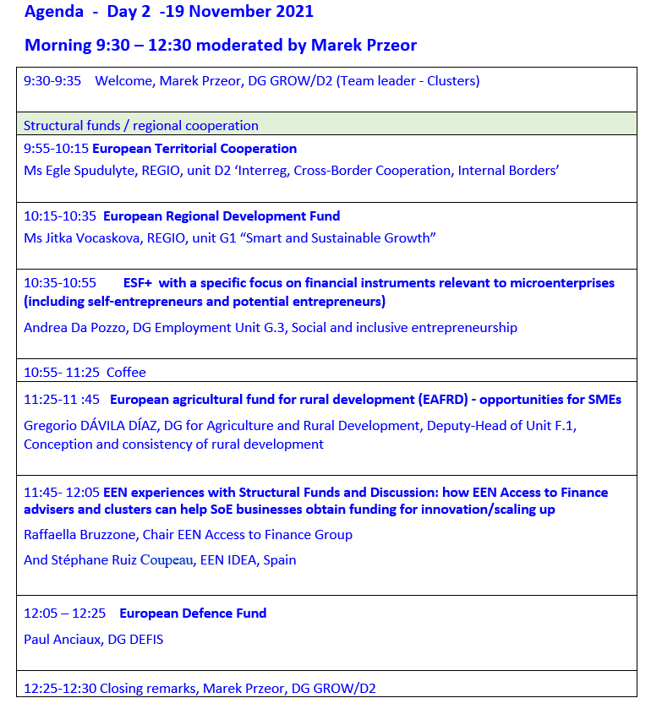
Agenda:

Slide 3
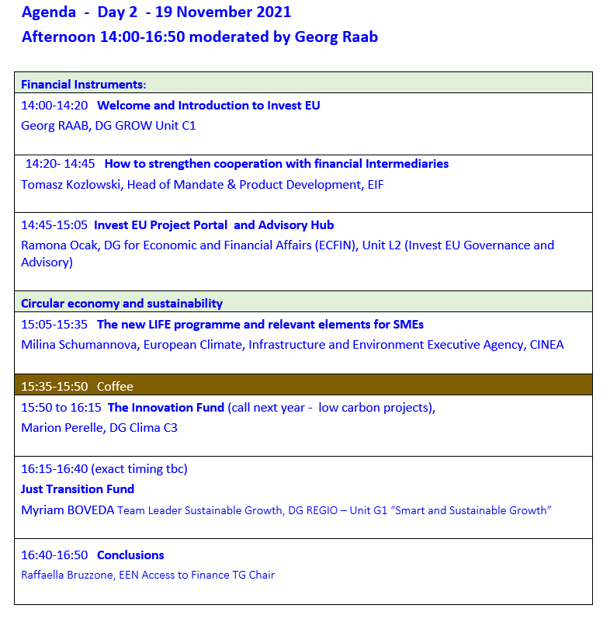
Agenda:

Slide 4
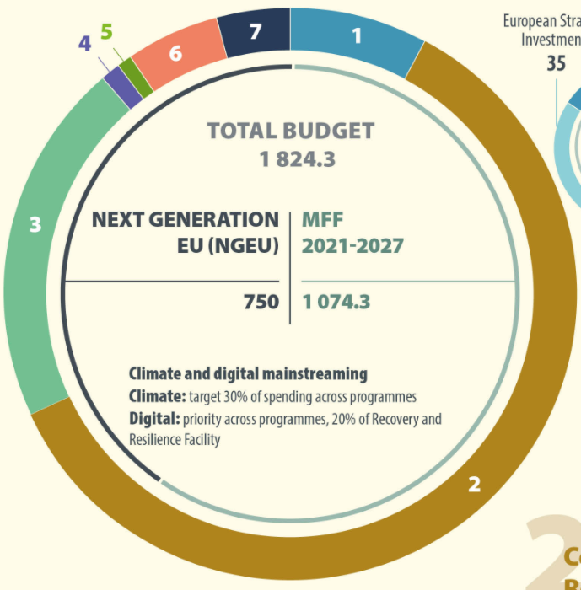
Multiannual financial framework 2021-27 and next generation EU
Long term EU budget 2021-2027 and Next Generation EU - Consilium (europa.eu)
Multiannual Financial Framework 2021-2027 (in commitments) | European Commission (europa.eu)
Before you apply: EU funding for beginners | European Commission (europa.eu) Funding by management mode | European Commission (europa.eu)

Slide 5
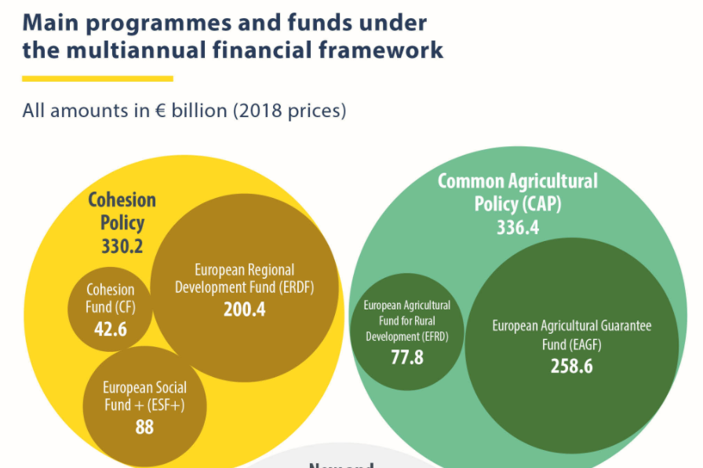
70% of EU funding is distributed through shared management
Funding by management mode | European Commission (europa.eu)
Funding by management mode | European Commission (europa.eu)

Slide 6
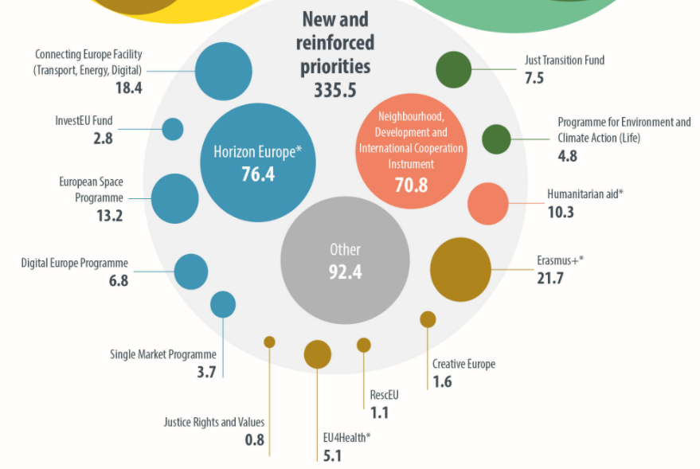
Other relevant programmes for SMEs

Slide 7
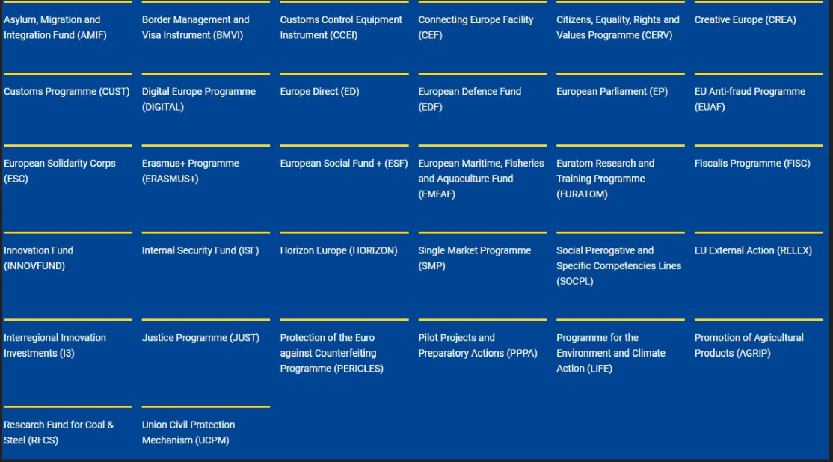
Funding & tenders (europa.eu)
11

Slide 8
Clusters need to look for all possible sources of financing
Clusters
EU funding
Public budget
Promotional banks
own resources
Crowd funding
EU public financial
seed/PE/VC
Institutional Investors
Commercial/ Investment banks
- THROUGH clusters channelled to final recipients, in particular SMEs (like in Euroclusters)
- WITH clusters to provide specialised services to any economic actor in need e.g. technological advise, upskilling (e.g. sustainable advisors)
- BY clusters to mix private and public, align local, regional, national and EU funding, reach out to financial providers across EU territory (start-ups, attracting private investors)
- FOR clusters to build their capacity to facilitate collaboration, capitalise technological and market intelligence, offer services (e.g. from ERDF)
Training on EU funding: 18-19 November 2021
The Clusters participants are registering through the EU survey form: https://ec.europa.eu/eusurvey/runner/AccesstoFinanceTrainingNov2021

Slide 9
Thank you
https://ec.europa.eu/growth/industry/policy/cluster_en
http://www.clustercollaboration.eu
@EU_Growth
@ThierryBreton
@Clusters_EU
@EREK_EU
https://www.linkedin.com/company/european-cluster-collaboration-platform-eccp/
https://www.linkedin.com/company/resource-efficient/
Visit the new ECCP, create/update your profile
© European Union 2020
Unless otherwise noted the reuse of this presentation is authorised under the CC BY 4.0 license. For any use or reproduction of elements that are not owned by the EU, permission may need to be sought directly from the respective right holders.

