Slide 1
Ramona Ocak
Policy Officer
DG Economic and Financial Affairs (DG ECFIN)
InvestEU Governance and Advisory (ECFIN.L2)

Slide 2
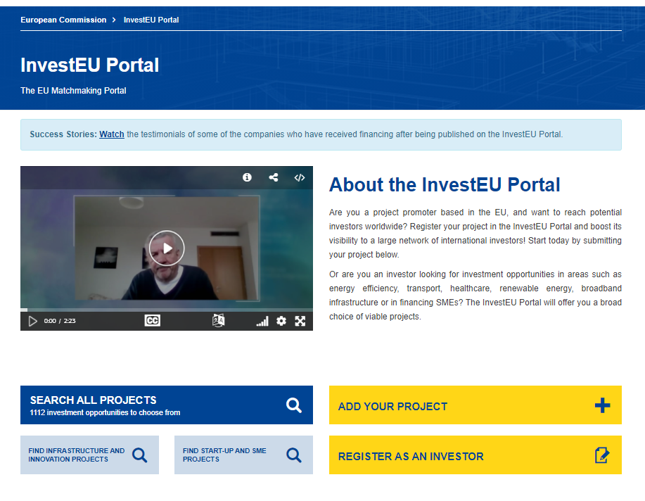
InvestEU Portal Bringing together promoters with investors
EU Promoters
International Investors

Slide 3
The new InvestEU Programme InvestEU Portal one of the 3 components

Slide 4
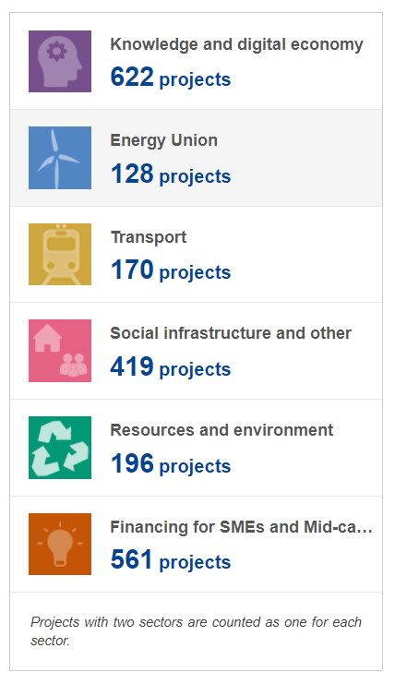
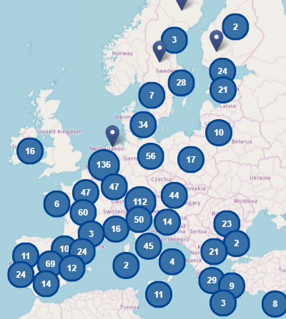
InvestEU Portal Promoters
To be eligible for publication, a project shall:
have a minimum size of EUR500000;
be active in one of the pre-determined high economic value-added sectors;
be situated and be promoted by a public or private legal entity established in an EU Member State;
have started or be expected to start within three years of the date of submission;
be clearly described as an investment project;
be compatible with all applicable EU and national laws.

Slide 5
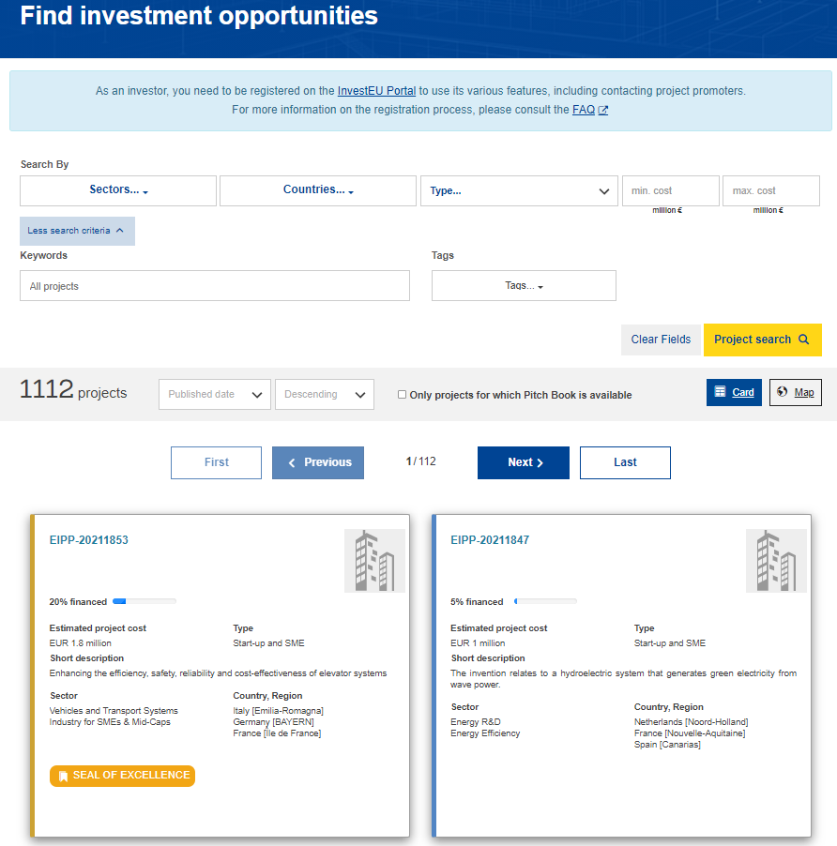
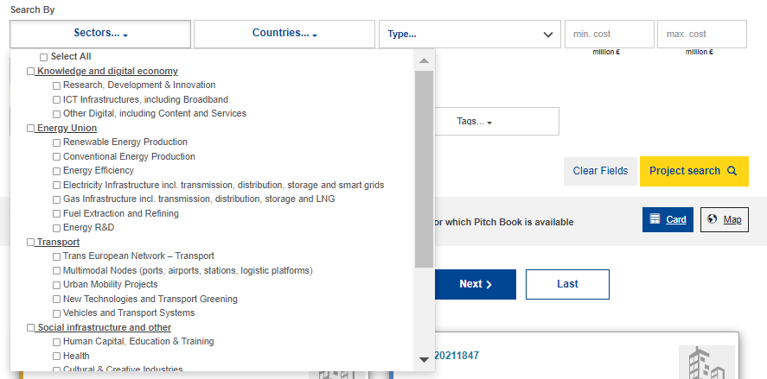
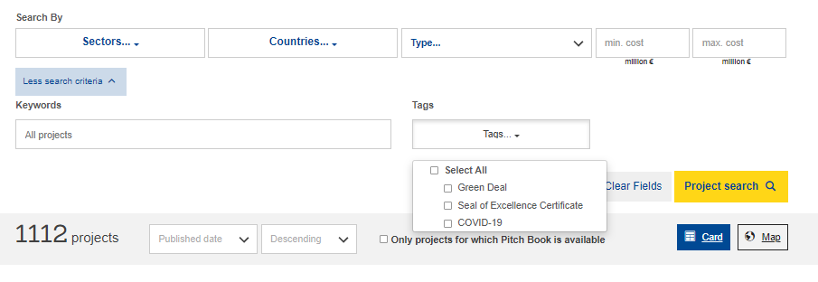
InvestEU Portal Promoters

Slide 6
InvestEU Portal Investors
300+ investors registered on the Portal
11 success stories to watch on ec.europa.eu/
investeuportal
Benefits for Investors:
One-stop-shop of European projects
Harmonised format of projects to invest in
Filtering options based on preferences
Tailored notifications on new and updated projects
Pitchings and one-to-one meetings at InvestEU Portal events
Direct contact through the Portal
Financing Types of Investors:
Business Angels
Venture Capital
Business Incubators
Equity
Loan
Grants
80+ projects received financing after publication

Slide 7
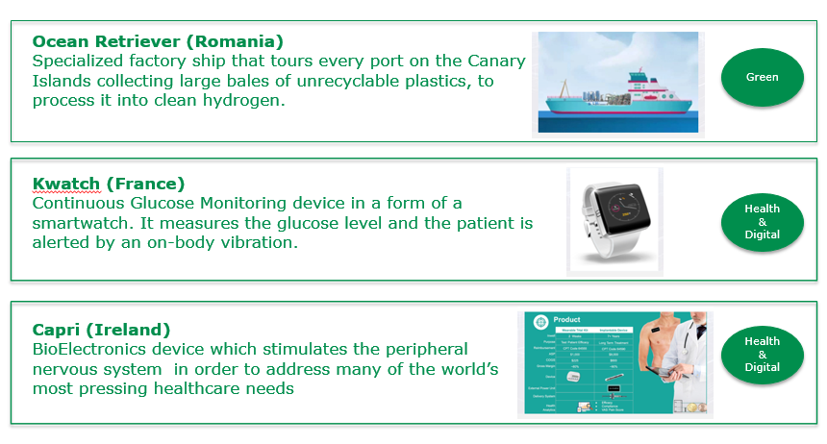
Portal Success Stories

Slide 8
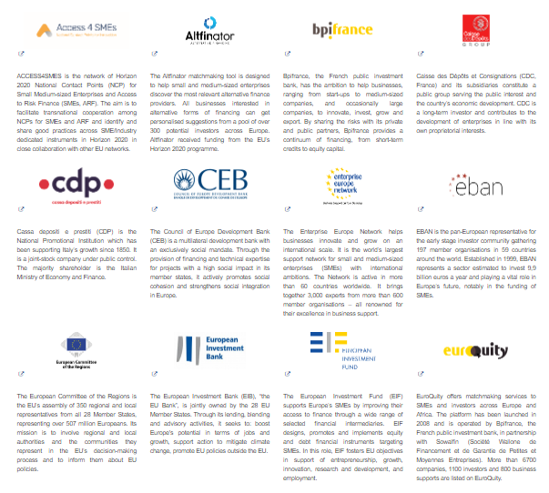
EEN & InvestEU Portal Cooperation
New features important for EEN members:
Minimum threshold was lowered to 500,000EUR
More visibility through tagging system
Only validated investors can view projects and contact project promoters
Companies established outside the EU may submit projects provided that the projects are implemented in the EU
Direct link to InvestEU Fund and InvestEU Advisory Hub

Slide 9
InvestEU Advisory Hub
central entry point for project promoters and intermediaries seeking advisory support and technical assistance related to centrally managed EU investment funds
connects project promoters and intermediaries with advisory partners, who work directly together to help projects reach the financing stage
supporting the identification, preparation and development of investment projects across the European Union
Who can apply for advisory support?
Private project promoters
Public promoters (including Member States central and local authorities) and
Financial and other intermediaries implementing financing and investment operations for the benefit of entities that face difficulties in obtaining access to finance.

Slide 10
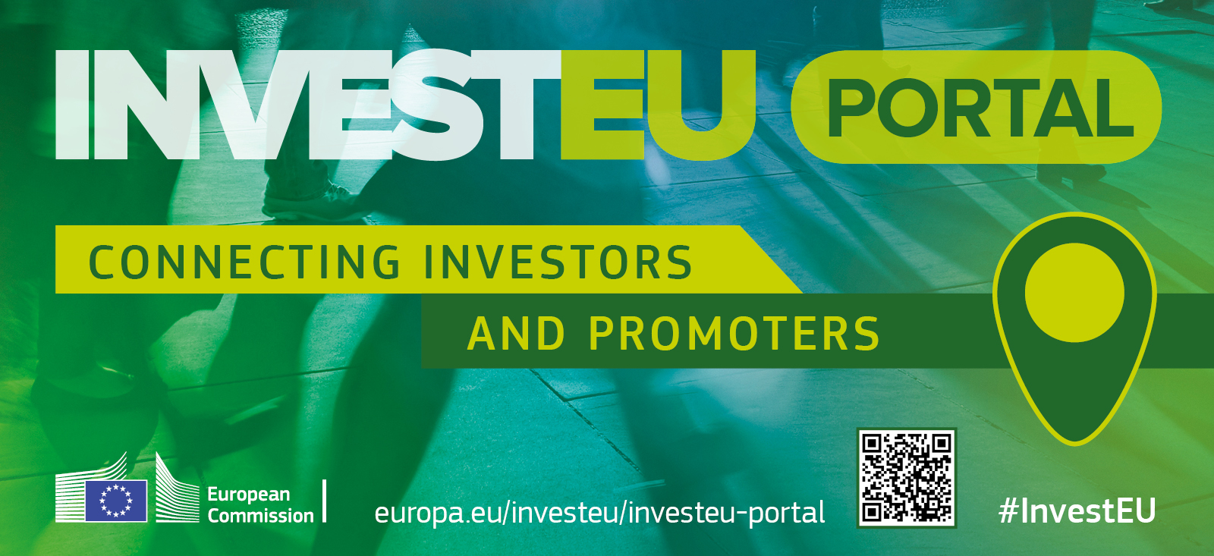
Thank you!

