Slide 1
Innovation Fund

Slide 2
Scope
Scaling up clean tech
Production and use of Renewable energy
including manufacturing plants for components
Carbon Capture Use and Storage
Energy-intensive industries
including substitute products
Energy storage
including manufacturing plants for components

Slide 3
Key features
Volume of at least EUR 20 billion until 2030 (at EUR 50 carbon price)
Support of up to 60% of additional costs related to innovative technology
Support of additional capital and operating costs (up to 10 years)
Financed from the revenues of the EU Emissions Trading System
Annual calls for large-scale and small-scale projects (CAPEX < EUR 7.5 million)
Single applicant or consortium
40% of grant disbursed at financial close
60% of grant disbursed during 10-years operating period against GHG emission avoidance
Project development assistance by EIB

Slide 4
What do we finance?
60% of your relevant costs
Large-Scale
Small-Scale
Relevant costs = additional costs resulting from application of the innovative technology
Both CAPEX and OPEX
Relevant costs = total project CAPEX
Max EUR 4.5 mn

Slide 5
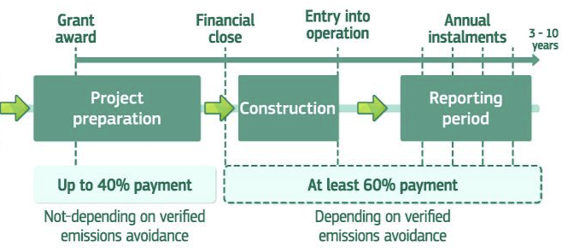
Grant Disbursement
10

Slide 6
Award Criteria
DEGREE OF INNOVATION
GHG EMISSIONS AVOIDANCE
PROJECT MATURITY
SCALABILITY
COST EFFICIENCY
  Beyond state-
  First-of-a-kind project at commercial scale
  Absolute emissions avoidance
  Relative emissions avoidance
  Technical maturity
  Operational maturity
  Financial maturity
  Market potential
  Project & regional level
  Sector level
  Economy level
  EU contribution requested per tCO₂ avoided

Slide 7
Results of first calls
Call for small-scale projects
Project development assistance for 15 projects
Grants of EUR 1145 million for seven projects
Grants of EUR 118 million for 32 projects
Project development assistance for 10 projects
Call for large-scale projects

Slide 8
Innovation Fund grants of € 1145 million for seven first-of-a-kind projects
Kairos-at-C - Port of Antwerp (BE)
Green hydrogen from water electrolysis and blue hydrogen with CCS, storage in North Sea
TANGO (IT)
K6 (FR)
Hybrit (SE)
Carbon capture from hydrogen, ammonia and ethylene oxide production and storage in North Sea, innovative shipping
BECCS Stockholm (SE)
Bifacial heterojunction photovoltaic cells production at GW scale
ECOPLANTA (ES)
CCUS at cement plant with storage in North Sea and carbon use for concrete production
Bio-based methanol from municipal waste
SHARC (FI)
Hydrogen-based direct reduction for steelmaking, including electrolyser
Bio-energy carbon capture at a combined heat and power plant and storage in North Sea – negative emissions

Slide 9

Innovation Fund: first call for small-scale projects
232 proposals were submitted in March 2021
175 proposals were deemed admissible and eligible
38 proposals passed all thresholds
32 proposals were selected for grant preparation
requesting €118.4 million

Slide 10
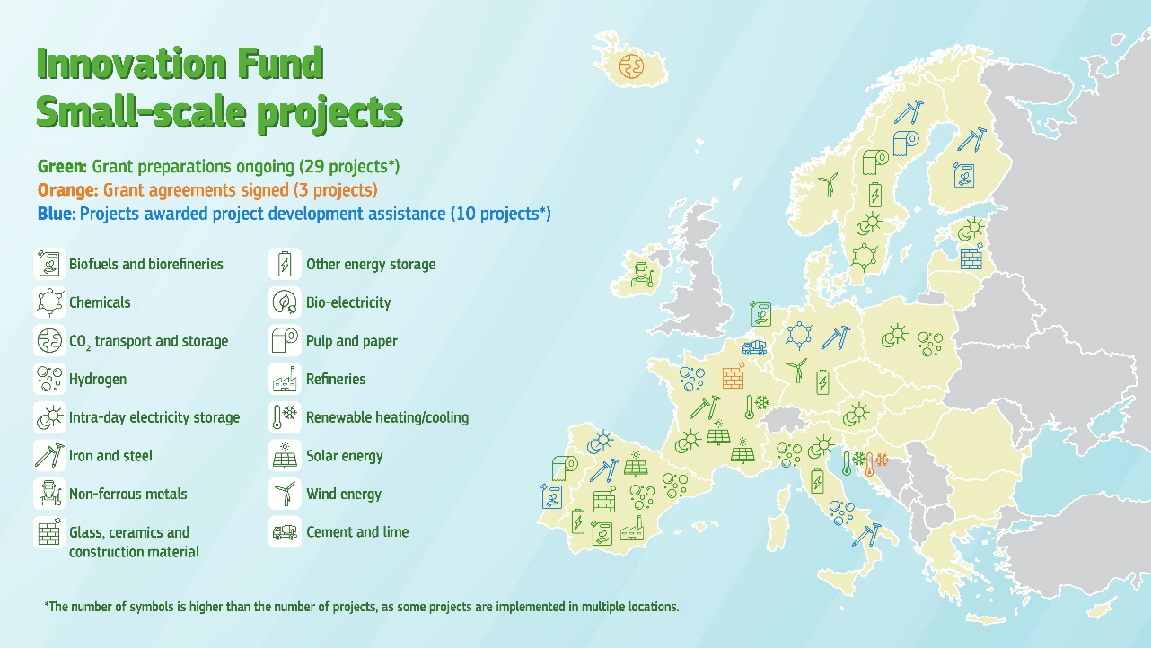

Slide 11
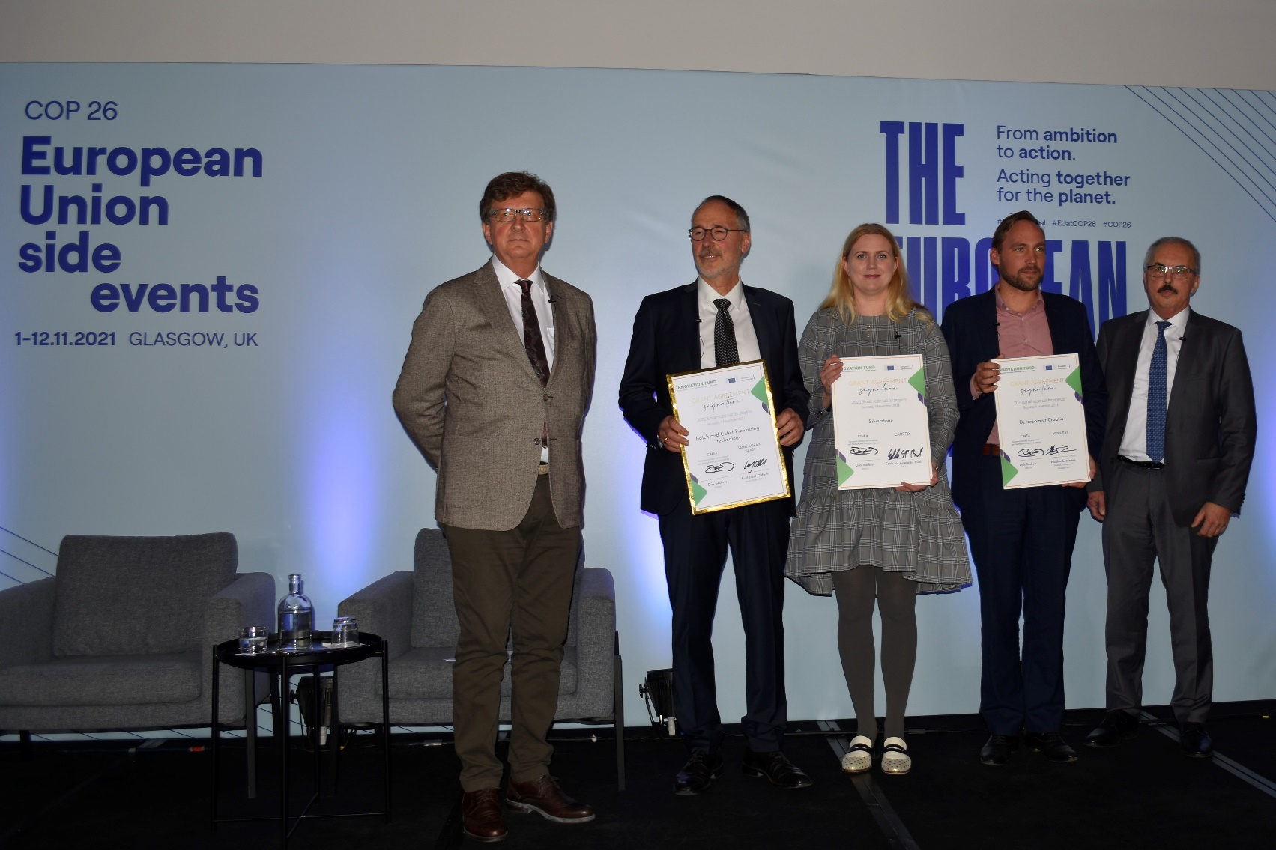
First Innovation Fund grant agreements signed
3 small-scale projects focusing on:
decarbonisation of glass production in France
renewable heat for an energy-intensive malt production process in Croatia
CO₂ capture and mineral storage in Iceland

Slide 12
Some recommendations
Start early preparing your application and make sure to have all the supporting documents ready on time
Read carefully all the requirements (including the admissibility and eligibility ones)
Get familiar with and follow the call methodologies and guidance (GHG and relevant costs)
Use our helpdesk
Do not wait the last day to submit
Before submitting, please check consistency between different parts and documents of your application

Slide 13
Innovation Fund – 2nd call for large-scale projects
Call text largely similar to first call
Grants of EUR 1.5 billion
Easy resubmission for the projects which were not selected in the 1st call
Only targeted improvements based on feedback from first calls
Stable documents to allow better guidance for new applicants
50% increase compared to first call
Project development assistance available for 20 promising projects
Already open
Launched on 26 October 2021
Submission deadline on 3 March 2022
Results from single-stage evaluation expected for Q3 2022

Slide 14
Next steps
3 March 2022
13 January 2022
Submission deadline for second call for large-scale projects
Seminar on lessons learnt from first call for large-scale projects
March 2022
Launch of second call for small-scale projects
Expected submission deadline late August 2022

Slide 15







Where to find more information?
All (past) call documents available on the Funding and Tenders Portal including:
Further info, planning of new calls, recorded webinars and videos available on the IF Website:
Guidance and calculation tools on GHG emissions and relevant costs
Frequently asked questions
https://europa.eu/!rx34Dt
https://europa.eu/!QB67by
Innovation Fund - YouTube
https://bit.ly/2WxK8w7

