Slide 1
Just Transition Fund
Myriam Bovéda Team leader Sustainable Growth, DG Regional and Urban Policy, European Commission
Training session for EEN and clusters organisations on
EU Funding Programmes and Financial instruments, 19 November 2021

Slide 2
CLIMATE
PACT AND CLIMATE
LAW
PROMOTING
CLEAN
ENERGY
INVESTING IN
SMARTER, MORE
SUSTAINABLE
TRANSPORT
PROTECTING NATURE
STRIVING
FOR GREENER
INDUSTRY
THE EUROPEAN
GREEN DEAL
FROM FARM
TO FORK
ELIMINATING
POLLUTION
LEADING THE
GREEN CHANGE
GLOBALLY
ENSURING
A JUST TRANSITION
FOR ALL
MAKING
HOMES ENERGY EFFICIENT
FINANCING
GREEN
PROJECTS

Slide 3
Just Transition Mechanism
to support and finance regions most exposed to transition challenges in all Member States
Just Transition Fund
(EUR 19.2 billion)
InvestEU
Dedicated Just Transition Scheme
Public sector loan facility with the EIB
Provides primarily grants
Crowds in private investment
Leverages public financing
The JTM includes a governance framework centered on territorial just transition plans

Slide 4
Just Transition Fund Allocations

Slide 5
CARBON-INTENSIVE INDUSTRIES
FOSSIL FUELS
Fossil fuel mining and extraction will face a significant decline
highly-greenhouse gas intensive activities will undergo a deep transformation
Regions and territories highly dependent on these activities will need to:
restructure their industries,
ensure that new economic activities can keep the economic and social texture together, respecting the environment, and
provide the necessary training to the workers concerned to find new jobs.

Slide 6
Commission recommendations: priority sectors
COAL / LIGNITE
PEAT
METALS
CHEMICALS
CEMENT
FERTILISERS
SHALE OIL
PETROLEUM REFINERIES
FOSSIL FUEL BASED ENERGY PRODUCTION
OTHER

Slide 7
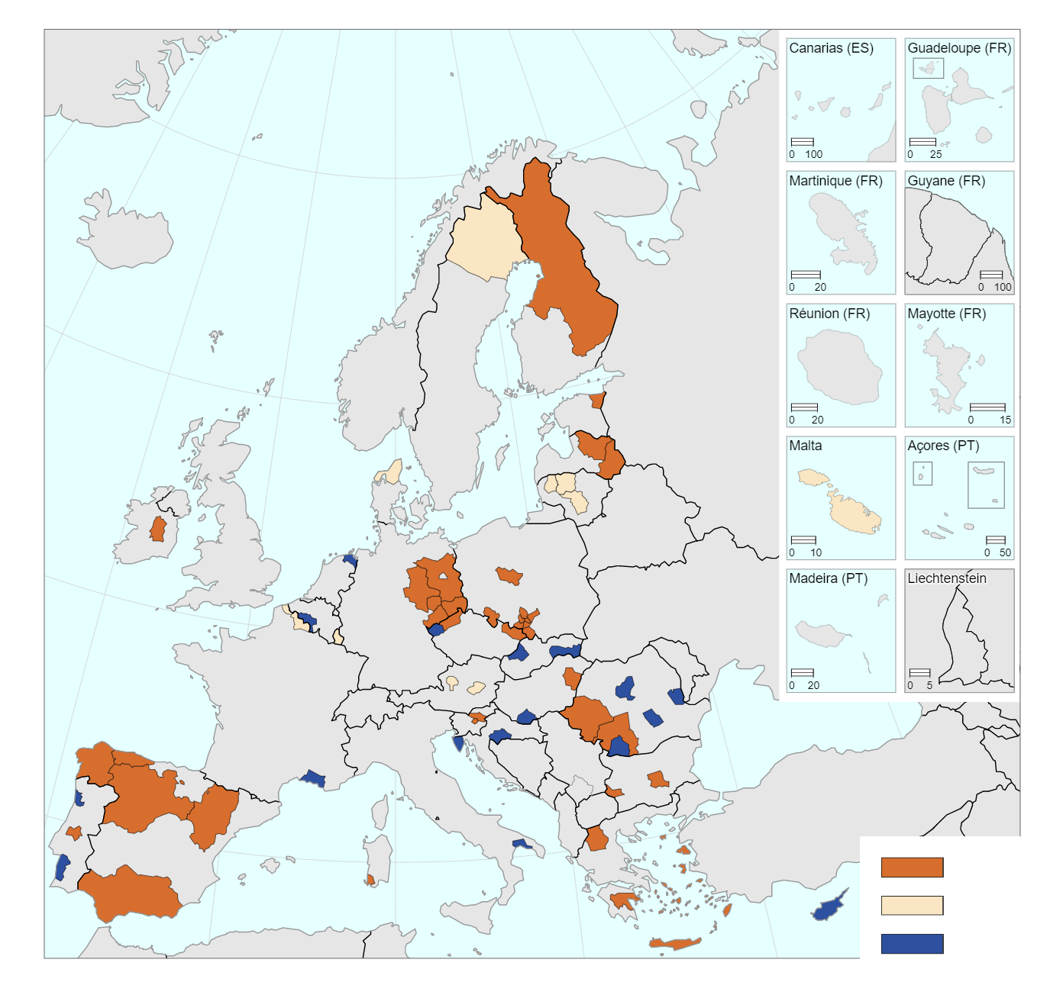
JTF geographical scope
Commission recommendations: European Semester Country Reports 2020, Annex D bis
Requests for extension should take into account:
sector undergoing transition
definition of the area (incl. evolution of population covered)
coherence with Annex D bis (incl. resulting aid intensities)
negative socio-economic impacts to be addressed (incl. potential job losses linked to climate transition)
Formal validation happens by adopting the Programmes
Fossil fuels production and fossil fuel based energy generation
Carbon-intensive industries
Both of the above

Slide 8
JTF programming
“Member States shall prepare, together with the relevant local and regional authorities of the territories concerned, one or more territorial just transition plans” (JTF Regulation)
Possibilities of programme architecture:
Programming level: national or regional or combination of both
Programming options under mono-fund and multi-fund programmes:
Option 1: JTF axis in an ERDF or CF monofund programme
Option 2: JTF axis in an ESF monofund programme
Option 3: JTF axis in an ERDF/CF/ESF multifund programme
Option 4: JTF in a self-standing JTF monofund programme
TJTP: part of cohesion policy programmes

Slide 9
The socioeconomic logic of the TJTPs
A territory faces social, economic and environmental challenges of the transition towards a climate-neutral economy, because it relies heavily on fossil fuels – especially coal, lignite, peat, oil shale – and/or carbon-intensive industries.
A territory sets out a transition process, which foresees:
1. What will happen with the regional economy and with the economic sectors concerned?
2. Will they be phased out? Or will they have to transform?
3. What is the impact on workers and local communities? How will the economic fabric of the territory be redeveloped?
What activities beyond diversification?
1. Is there a need to support investments in ETS sectors to achieve significant reduction of emissions and preserve jobs?
2. Is there a need to support investments in large enterprises to offset job loses?

Slide 10
Just Transition Fund: scope of support
Stronger focus in scope of intervention than other cohesion programmes
Economic diversification and reconversion
Re-skilling and job seeking assistance for workers
Support to climate and environmental sustainability, where this will help mitigate the impact of the transition
Limited additional eligibility – to be justified in territorial just transition plans
Productive investments in large enterprises: if needed to offset job losses
Investments reducing GHG emissions from ETS activities: if needed to preserve jobs
Exclusion from the scope of support :
Production, processing, distribution, storage or combustion of fossil fuels excluded from support
Each operation must contribute to the implementation of the territorial just transition plans
Exclusive list of activities defined in Article 4 of the JTF regulation

Slide 11
Next steps: working together to optimise impact
Strong partnership: involvement of all relevant stakeholders in the preparation of cohesion policy programmes
Strong programmes: objective setting, types of actions, synergies, funding, outputs and results
Awareness raising, coordination and cooperation between national and regional actors

Slide 12
More information
https://ec.europa.eu/info/eu-regional-and-urban-development
Managing authorities - Regional Policy - European Commission (europa.eu)

Slide 13
myriam.boveda@ec.europa.eu DG REGIO, Smart and Sustainable Growth Unit
Contact

Slide 14
Supporting specific operations?
Even if an operation is eligible, its possible support depends on the outcome of the programming negotiations between Commission and Member State
Framework of the discussion: European Semester Country Report 2020 (Annex D)
Final decision: approval of Programme with annexed TJTP
In addition, the following considerations apply for any operation:
It contributes directly to the JTF specific objective
It follows the general logic of the TJTP and contributes to its implementation
It takes horizontal principles (e.g. ‘do no significant harm’) into account, see Art. 6a CPR
It is in line with provisions of selection of operations, see Art. 67 CPR

Slide 15
Additional considerations for large enterprises
In accordance with Art. 4 JTF, the TJTP needs to demonstrate that such investments fulfil the following conditions:
they are necessary for the implementation of the TJTP;
Question: “gap analysis” to be included in TJTP?
The gap analysis should include the difference between the expected job losses and the potential of job creation through JTF support (e.g. economic diversification investments for SMEs). The latter can be based on historical evidence of job creation by SMEs in the territory, analysis of current employment by SMEs in the region, surveys on employment perspectives, or other methodologies
they contribute to the transition to a climate-neutral economy by 2050 and to related environmental targets;
they are necessary for job creation in the identified territory;
they do not lead to relocation for mitigating job losses resulting from the transition, by creating or protecting a significant number of jobs; and
they do not lead to or result from relocation

Slide 16
Additional considerations for ETS activities
In accordance with Art. 4 JTF, the TJTP needs to demonstrate that such investments fulfil the following conditions:
they contribute to the transition to a climate-neutral economy;
Question: “significant number of jobs” in TJTP?
The number of protected jobs should be estimated in a tailored way, with regard to the overall jobs of the concerned economic operators and the labour force in the concerned territories.
they lead to a substantial reduction in GHG emissions going substantially below the relevant benchmarks established for free allocation under the ETS Directive; and
they are required for the protection of a significant number of jobs in a given territory

