Slide 1
EEN Access to Finance ERDF and support for SMEs: smart growth Jitka Vocásková DG Regional and Urban Policy Unit G1 – Smart and Sustainable Growth 19 November 2021
#CohesionPolicy #EUinmyRegion

Slide 2
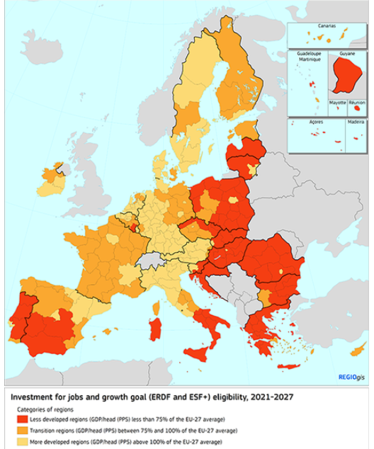
What is EU Cohesion Policy?
First EU public investment policy
Aim: foster growth, jobs and convergence by supporting competitiveness
2014-2020:
Invested: € 670 billion (200+ for R&I, ICT, SME)
600,000 SMEs supported (110,000 in R&I / ICT)
2021-2027: 400 billion for jobs and growth
Managed by countries and regions

Slide 3
ERDF: Scope of support
Investments in smarter, greener, more connected and more social Europe that is closer to its citizens
The ERDF can support:
investments in infrastructure
investments in access to services
productive investments in SMEs
equipment, software and intangible assets
information, communication, studies
networking, cooperation, exchange of experience

Slide 4
Priorities for innovative & smart economic transformation
Innovation & Research: business investments in R&I, activities linking research to business environment, uptake of advanced technologies
Digitalisation: ICT uptake in SMEs
Competitiveness of SMEs: new firms, growth of start-ups/ scale-ups, access to advances business services and access to finance
Skills: innovation management in SMEs, specific skills in companies

Slide 5
What projects can we finance? (1)
SME investments in research & innovation
SME cooperation with universities/research centres
SME investments to safeguard and create jobs
Creation of new firms, growth of start-ups / scale-ups
SME internationalisation
SME participation in global value chains
Notes:
A few examples:
SME Investments to create jobs / new firms / growth of start-ups:
Projeto MpDS: Medical pre-Diagnostic System
Creation of an integrated and flexible mobile solution to acquire medical images with various types of magnifications, which can be used for diagnosis in a wide spectrum of pathologies.
Polopique Strategy: New value added products
This project aims to increase the capacity of Polopique Fabrics, through advanced technology that contributes to the production of new and differentiated products, such as innovative fabrics with unique combinations of different types of yarns with extremely thin thicknesses.
SME participation in global value chains (and in cooperation with Universities)
Automotive sector: creation of small supplier club organized by Bosch to foster innovation in the sector, with the cooperation of Minho University in Portugal.
SME COOPERATION WITH UNIVERSITIES (R&D project leaded by SMEs with the cooperation of universities):
University of Coimbra creates energy generating system in pavements. It’s the PAVENERGY project, whose objective is the development and implementation of a system inserted in the pavement for the production of electric energy
More examples can be found in the Compete 2020 Website: Newsletter (compete2020.gov.pt)

Slide 6
What projects can we finance? (2)
SME access to finance
Advanced business services for SMEs
ICT up-take in SMEs
Trainings and re-skilling for SMEs
Notes:
A few examples:
SME INTERNATIONALISATION
Attending business fairs, developing brands, market study
SME access to finance
FEEDZAI (security systems). Starting with a small investment with venture capital 2007-2013 ERDF fund, now it is a “Unicorn”(worth more than 1 billion euro).
ICT up-take in SMES
E-commerce platforms, digitalization of production and management processes.
ENERGY EFFICIENCY:
NTW-DAS project: to create better conditions for energy efficiency in the rail sector. This project creates a product to increase energy efficiency, based on technologies and recent state of the art, and with enormous potential for expansion to other rail systems. A solution to support the trains drivers that allows the global optimization of the rail transport network, avoiding unnecessary stops.

Slide 7
What kind of support?
Typically grants, also financial instruments (loans, guarantees, equity)
Combination also possible in the same project:
First stage: grants for early, less profitable period
Second stage: financial instruments when generating revenue
Please check with your EU Funds’ Managing Authority the best fit
If financial instrument, they will help you engage with financial intermediary

Slide 8
How can you apply?
New programmes will start in 2022
Contact your regional government, ministry for economy / regional development (EU funds managing authority)
Check funding opportunities / calls on EU / national / regional portals

Slide 9
Questions?

