Slide 1
EEN experience: Advise on Structural Funds and SoE Businesses
EEN Access to Finance Training Session
November 18 – 19 2021
Notes:
1

Slide 2
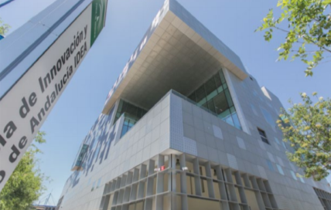
Regional Ministry of Economic Transformation, Industry, Knowledge and Universities
Agency of Development and Innovation of IDEA
Infrastructures, Productive Spaces and Technology Sectors
Enterprise Europe Network
FDI and Advanced Services
Grants
Financing and Business Development
Financial
Instruments

Slide 3
Grants
Program for Industrial Development, Improvement of Competitiveness, Digital Transformation and Company Creation
2014-2020
145 ->195 MIL €
Creation of business activity
Improvement of competitiveness
Employment generation
Advanced services
Digital transformation of SMEs
Open call until 12/2020

Slide 4
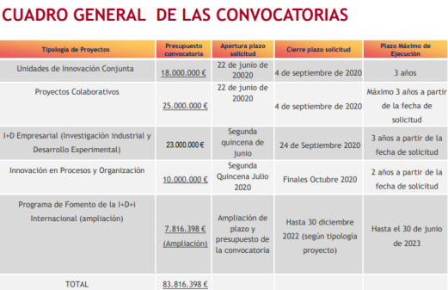
Grants
Program for the Promotion of Industrial Research, Experimental Development and Business Innovation
2014-2020
84 MIL €

Slide 5
GRANTS PROGRAM FOR
THE PROMOTION OF INTERNATIONAL R&D&I
Support to SMEs in submitting projects within international calls
Funding the a contractor to carry out tasks related to partners research and proposals drafting.
International launch of Innovative Enterprises
Projects aiming at setting up Innovative Business plans for SMEs having applied to SME´s Instrument Phase 2 (HORIZON 2020), reaching to the threshold within European Commission evaluation, but without receiving funds for budgetary reasons.
International R&D&I Projects
Experimental Development projects developed by Andalusian enterprises beneficiaries of an international action within Research Area (ERAnets, «Joint Programming Initiatives»- JPI, «Joint Technology Initiatives»- JTI, etc) or an international agreement (Eureka, Iberoeka)
Direct, non-repayable incentives. GRANTS

Slide 6
Dissemination of SME Instrument
(Workshops, InfoDays, etc.)
SoE SMEi
Advice Submitting Proposal
Information on CDTI´s “Horizonte PYME" is offered
SoE
The company gets
Phase 1
SME Instrument funding
Yes
The KAM/Business Coaching service is provided
Advice Submitting Proposal
Call for Proposal “Lanzamiento internacional Empresa Innovadora“ is offered
The company gets
Phase 2
SME Instrument funding
SoE
The KAM/Business Coaching service is provided
Yes

Slide 7
COMPARATIVE SCHEMES SMEi SoE
 | SMEI2 FUNDED BY EC | SMEI2 ACFP
Incentive Effect | Does not exist | Submition date
Resolution Time | 2 weekS | SM time + Submission time + Revaluation time +
Categories of R&D Activities | No Califications: TRL 2,7 | According to State Aid Rules: IR or ED
% grants | 70% (in some cases, 100%) | 35%-50
Elegible Cost | Broad flexibility | Narrow aproach
Payment | >40% , No guarantee | It depends on the national rules
Report | Focused on the result | Focused on administrative isues
Prototipye/Pilot Project | No barriers for selling | Specific Conditions
Finantial feasibility | NO | YES

Slide 8
Our experience
Impact of the mismatching on the rules governing the application of H2020 and ERDF: State Aid and Eligible Expenditures. Similar projects (even the same) should be analyzed using the same rules.
Concerns of uncertainty for regional (or national) auditing authority regarding the fully application of compatibility among funds.
Seal of Excellence case: We need to talk about exactly the same project (budget, scope, WP, deliverables, etc…)
Complexity of project management and the financial / economic justification.
We are not creating “Civil Servants incentives”: We don’t receive incentives to incorporate synergies in public programs. Very risky and the mistake is highly penalized.

Slide 9
Implementation of Public Financial Instruments in Andalusia
Private Investors
Regional Funds
(Andalusian Government)
European Structural & Investment Funds (ERDF)
Fund of Fund (Fondo público andaluz para la financiación empresarial y el desarrollo económico)
Financial Instruments
Fund of Fund Manager / “Agente Financiero”
(Agencia IDEA)
SOPREA
Second floor facilities
VC Fund (early/later stage)
direct venture financing
VC Fund Manager
Bank
Final Beneficiary
Final Beneficiary
Final Beneficiary

Slide 10
Fund of Venture Capital funds
Recent launch 3 new venture capital funds which global amount of 50,25 Mil € co-financed with ERDF
Startup Venture Capital is awarded to Quadriga Asset Managers.
8 Mil € public funds + 2,1 private funds
Expansion Venture Capital I is awarded to Axon Partners Group
19 Mil € public funds + 5 private funds
Expansion Venture Capital II is awarded to Alter Capital Desarrollo
10 Mil € public funds + 5,15 private funds

Slide 11
#ScaleUpAndalucia
email: info@ceseand.net
www: www.ceseand.net
Thank you!
Stéphane Ruiz
sruiz@agenciaidea.es
Notes:
These are just some of my Network colleagues. We are here to help you so please don’t hesitate to get in touch.

