Slide 1


Slide 3
































Singapore’s Startup Ecosystem
>220
Venture Capital Investors
>30
IHLs & Research Institutions
(Pitchbook, 2020)
>4,000
Tech startups
(Based on Startup SG Network, as of Aug 2022)
25 Unicorns
S$14.7B
funding raised across
>692 deals
(Source*, 2021)
Startup Communities
Innovation-Ready Corporates
>190
Accelerators/Incubators
Co-Working Spaces
*DealsSteet Asia, Crunchbase, Pitchbook, Pregin & admin data from Enterprise Singapore
(Enterprise Singapore, 2020)
*at least one employee, registered in the past five years, and more than 50% ownership by individuals

Slide 4












Strengthening Singapore’s connections to major innovation hubs around the world
South Korea
Tokyo
Germany
Seoul
Stockholm
United Kingdom
London
Berlin
Beijing
Paris
Munich
Jiangsu
France
Shanghai
San Francisco
Shanghai
Suzhou
Shenzhen
Turkey
Zhejiang
Israel
Manila
Bangalore
Ho-Chi Minh City
Singapore
Bangkok
Jakarta
Sao Paulo
GIA Acceleration Programmes (pilots)
Co-Innovation Programmes
Cape Town

Slide 5
Acceleration Programmes
Acceleration Programmes are structured programmes to help participants develop and execute go-to-market strategies and connect to business leads
GIA Acceleration Programmes
(Regular runs at set intervals per year)
Service Offerings by GIA Partners
(On-demand)
Selection & Prep
Acceleration Programme
Service Offerings
z
z
z
2-10 weeks
Mentors and subject-matter experts
Selection and curation of startups
Business workshops
Business Services – hiring, accounting, banking, etc.
Dedicated mentoring and coaching sessions
Tailored go-to-market strategy for each startup
Incorporation and legal services, etc.
Targeted business matching, networking sessions & demo days
Targeted business facilitations
Fostering international partnerships is core to our Innovation strategy, GIA programmes operating in 15 cities, 11 countries worldwide

Slide 6












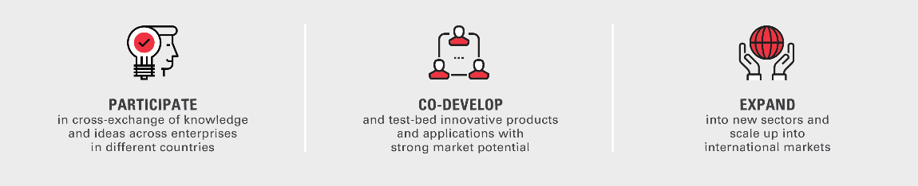
Co-Innovation Programmes:
Facilitating Cross-border Innovation Projects
What are co-innovation programmes?
Bilateral/multilateral partnerships with other governments to promote, facilitate and provide funding support for R&D and innovation projects between Singapore companies and companies from participating countries.
UK
Germany
France
Jiangsu
Turkey
Shanghai
South Korea
Israel
Zhejiang
India

Slide 7














Our CIP Network Has Grown Through Bilateral Partnerships and Membership in EUREKA
1997
2018
2019 - 2020
2021
2022
Israel
(SIIRD)
France
Germany
Shanghai, China
Associate Member of Eureka Network
Zhejiang, China
India
Jiangsu, China
Turkey
(EUREKA)
South Korea
(EUREKA)
United Kingdom
Eureka
GlobalStars*
Total Countries:
1
Total Countries:
3
Total Countries:
20
Total Countries:
37
*Partner Countries for Eureka GlobalStars: Austria, Belgium, Canada, Czech Republic, Denmark, Estonia, Hungary, Netherlands, Poland, South Africa, South Korea, Spain, Switzerland, Turkey, Ukraine, and the United Kingdom

Slide 8

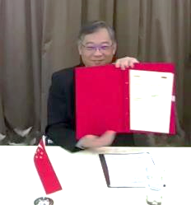
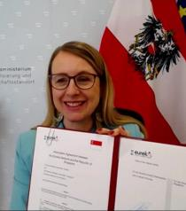
Central to Singapore’s Global R&D Collaboration Plans Was Our Accession to the EUREKA Network
Singapore was officially voted into EUREKA Network as an Associate Member by the EUREKA High Level Group on 25 February 2021. The Association Agreement was just signed on 18 May 2021.
EUREKA: Intergovernmental network launched in 1985. Aims to support market-oriented R&D and innovation projects among SMEs across all technological sectors. Comprises 41 full members states, 5 associate members (Argentina, Canada, Chile, South Africa, Singapore), and 1 partner country (South Korea).
Main instruments of cooperation within EUREKA Network
Network
Projects
Bilateral or multilateral calls for projects between two or more EUREKA countries
Clusters
Thematic calls for projects between two or more EUREKA countries
EuroStars
Joint programme co-funded from the national budget of 37 Eurostars participating countries and by the European Union through Horizon 2020.
Eureka Association signing ceremony by Singapore Minister for Trade and Industry, Mr Gan Kim Yong, and Austrian Federal Minister for Digital and Economic Affairs, Dr Margarete Schramböck.

Slide 9
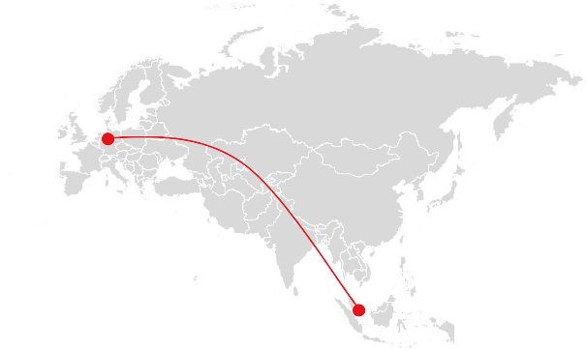



Co-Innovation Opportunities with Singapore
European companies are welcomed to collaborate with Singapore enterprises on joint R&D and innovative projects through the following platforms:
Collaboration with MNC/Corporates
Multilateral
Information Technology for European Advancement (ITEA) 4
Eureka Eurostars
SME-focused
Multilateral
The ITEA4 Call is an initiative that is part of the Eureka Clusters Programme, which supports companies to collaborate on software innovation projects in domains such as smart mobility, healthcare, smart cities and energy, manufacturing, engineering and safety & security.
Eurostars is the largest international funding programme supporting cross-border R&D collaborations between innovative SMEs from 37 countries, including Singapore and Germany, to create innovative products, processes or services for commercialisation.

Slide 10


Information Technology for European Advancement (ITEA) 4
ITEA4 is an Eureka Clusters call focusing on software innovation projects
What is ITEA4?
The ITEA4 Call is an initiative part of the Eureka Clusters Programme, which supports companies to collaborate on software innovation projects in domains such as smart mobility, healthcare, smart cities and energy, manufacturing, engineering and safety & security.
Programme information
Who can apply?
Guidelines for project proposals:
ITEA4 is open to software innovation projects in various domains.
Projects should focus on R&D / innovation, with intent to develop innovative products, processes, and services.
The project consortium must involve at least two independent companies from the 35 participating countries.
Benefits of participating
Application period
Opportunity to work with over 200 MNCs and corporates, and access partners across Europe such as government agencies, research institutes, SMEs and universities.
Gain access to the innovative value chain of corporates such as Bosch, Philips, and Volvo etc.
Tap on expert guidance for your project.
13 September 2022 – 15 November 2022
Website
For more information, please visit:
https://itea4.org/

Slide 11


Eureka Eurostars
Supporting cross-border R&D collaborations between companies from 37 countries
What is Eureka Eurostars?
Eurostars is the largest international funding programme which supports innovative SMEs wishing to collaborate on R&D projects to create innovative products, processes or services for commercialisation.
Programme information
Who can apply?
Guidelines for project proposals:
Eurostars is open to projects from all sectors.
Projects should focus on R&D and innovation, with the intent to develop innovative products, processes, and services.
Innovative SMEs and project partners (large companies, universities, research institutions and other types of organisations) from the 37 participating countries.
Benefits of participating
Application period
Gain access to public funding.
Join an ever-growing international network of SMEs, universities and research centres, and expert support.
Collaborate on innovative and market-driven R&D projects with like-minded international partners.
Acquire feedback on technical and commercial viability from multiple expert evaluation.
Two call for proposals each year:
Call 1: January – March
Call 2: July – September
Website
For more information, please visit:
https://www.eurekanetwork.org/countries/germany/eurostars/

