Slide 1
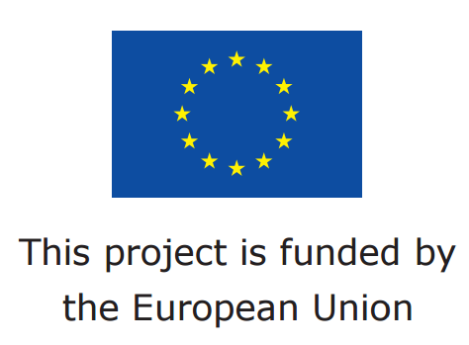
CETA Market Access Support Program for EU Business in Canada
Lucas Lanziotti
April 1, 2019
Hannover, Germany
Implemented in cooperation with the European Chamber of Commerce Canada (EUCCAN)

Slide 2
Program background & objectives
The CETA Market Access Program is a European Union funded project and has been successfully running since 2017.
Assist European business and particularly SMEs take full advantage of the CETA agreement
Help them gain comprehensive, sector specific information about the new opportunities CETA brings in terms of removing, market access barriers to trade with Canada.
Provide guidance to business on how to benefit from CETA while addressing challenges in their business strategies
Create sustainable channels of communication between EU businesses in or seeking to enter Canada and institutional stakeholders
Notes:
The CETA Market access Program is a European Union funded project and has been successfully running since 2017.
Its objectives include: assisting European business and particularly SMEs take full advantage of CETA
Help them gain comprehensive, sector specific information about the new opportunities CETA brings in terms of removing, market access barriers to trade with Canada.
Provide guidance to business on how to benefit from CETA while addressing challenges in their business strategies
Create sustainable channels of communication between EU businesses in or seeking to enter Canada and institutional stakholders

Slide 3
How is the Program useful to EU business?
CETA Market access studies and Sector Specific Market Entry guides
Quarterly articles on sector specific issues
Webinars with high-caliber CETA experts
Daily graphic and multimedia information through social media channels
Facilitated access to practical information:
Notes:
How is the Program useful to EU business? It provides facilitated access to relevant information
CETA Market access studies
CETA themed reports and Sector Specific Market Entry guides
Quarterly articles on sector specific issues
Webinars with high-caliber CETA experts
Daily graphic and multimedia information on CETA opportunities and most prominent current topics/news for EU businesses through social media channels on the most recent relevant topics
Sector-specific guides
Logistics and transport industry: About 20% of EU exports to Canada, major topic of gradually decreasing tariffs. Maritime industry could be included as well
Machinery products: About 20% of exports, considerable SME factor
Agri-food and drinks: About 10% of exports and grand majority are SMEs
Chemicals, including pharmaceuticals: About 18% of exports
ICT sector: Mainly a service - high concentration of SMEs, growing/promising sector of the future
Fuels and mining products: About 8% of exports
Services- with most prominent being environmental, telecoms and finance
Cleantech sector: A niche and up-and-coming sector with high concentration of SMEs and startups)
As these are the largest sectors in Canada-EU trade in both goods and services, guides have the potential to reach the greatest amount of EU businesses. For a more integrated approach of the communication deliverables, we can consider the first success story in complementarity with the guide (and other products such as social media posts)
CETA-themed report
Labour mobility: A direct matter of people and relevant to EU companies that already have presence in Canada or want to set up a presence.
Public procurement: A significant aspect of the agreement and major interest of EU companies
IPR: IPR again a major cross-cutting theme
Standardisation/accreditation process : Could potentially tie it into customs procedures.
Investment and investors : 35% of inward investment in Canada is from the EU, and with a growing trade relationship, this topic addressed by CETA can certainly be of interest.
Dispute settlement/resolution or investment protection (could be part of the previous theme): Although it has been proved a controversial topic among European audiences and not yet in force, still an important issue that EU businesses/investors could be very interested in.
Multifaceted communication and outreach with EU business and relevant stakeholders (intermediaries, EU chambers of Commerce and business organizations across Europe and Canada:
A database of key trade related contacts is developed to provide contact information for EU exporters seeking information on how to trade in Canada, for both goods and services. The database includes a full range of institutional stakeholders (e.g trade promotion bodies. Business support organisations etc) to ensure that EU business has readily available and up-to-date information on relevant contacts.

Slide 4
Multifaceted communication and outreach between EU business and relevant stakeholders across Europe and Canada:
Comprehensive database of key trade related contacts for readily access to up-to-date information http://www.euccan.com/database-of-key-trade-related-contacts/
Notes:
Multifaceted communication and outreach with EU business and relevant stakeholders (intermediaries, EU chambers of Commerce and business organizations across Europe and Canada:
A database of key trade related contacts is developed to provide contact information for EU exporters seeking information on how to trade in Canada, for both goods and services. The database includes a full range of institutional stakeholders (e.g trade promotion bodies. Business support organisations etc) to ensure that EU business has readily available and up-to-date information on relevant contacts.
Our Annual workshops aim to bring together companies, market entry experts, relevant stakeholder for an in-depth discussion on CETA market access matters.
We will also be present to a wide range of third-party events ( expert presentations, information booths, matchmaking sessions or even by scheduling pre-arranged meetings) You can get direct expert advice on CETA or get informed about the Program and how to tap into its resources.

Slide 5
Annual Workshops for in-depth discussion on market access
Program representation in a wide range of third party events (information booths, matchmaking sessions, pre-arranged meetings).
Events engagement:
Notes:
Our Annual workshops aim to bring together companies, market entry experts, relevant stakeholder for an in-depth discussion on CETA market access matters.
We will also be present to a wide range of third-party events ( expert presentations, information booths, matchmaking sessions or even by scheduling pre-arranged meetings) You can get direct expert advice on CETA or get informed about the Program and how to tap into its resources.

Slide 6
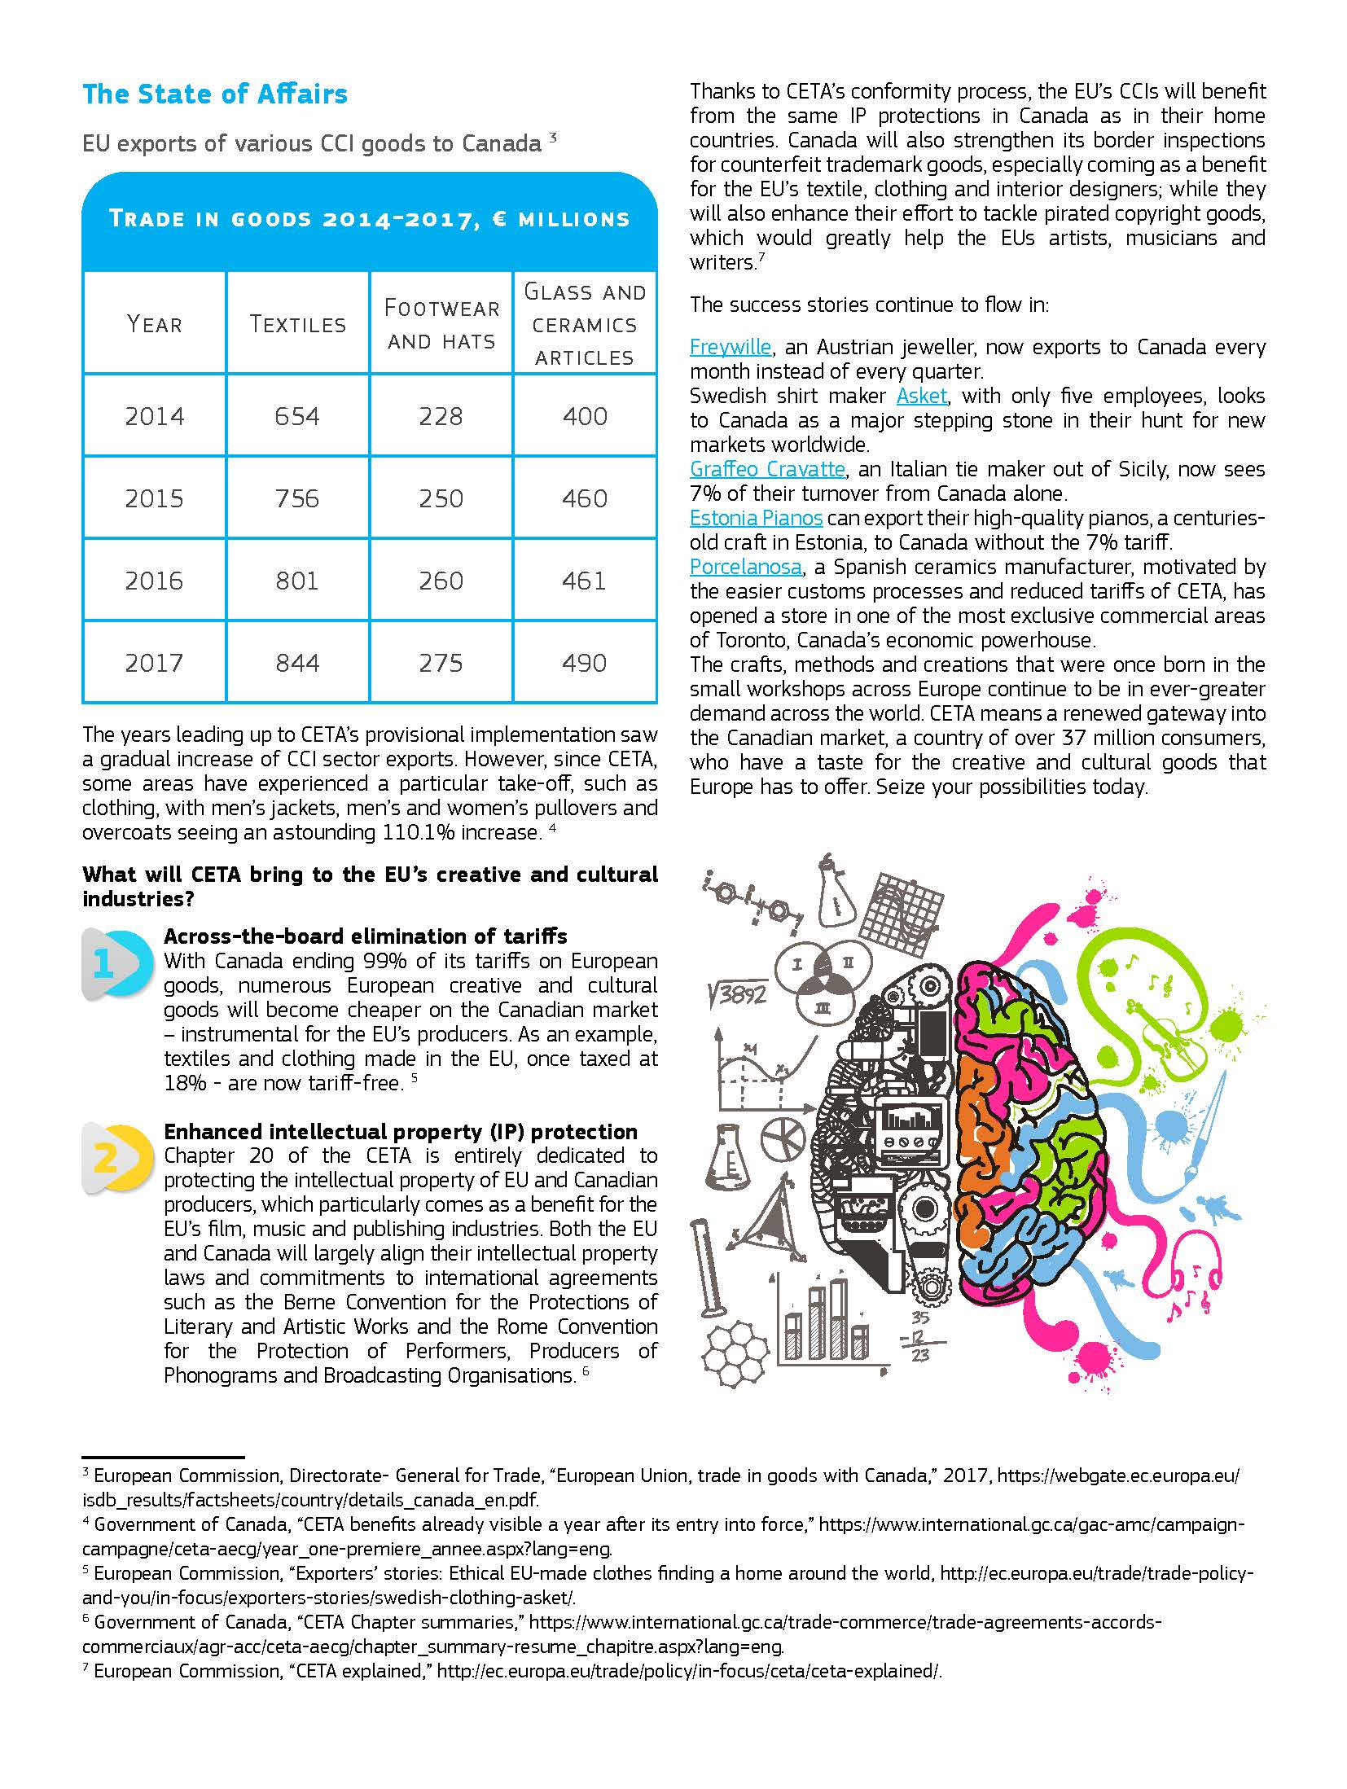
ARTICLES
VIDEOS
WEBINARS
GRAPHICS

Slide 7
How to tap into our resources
CETA Market Access Program
@EUCCAN_
European Union
Chamber of
Commerce
in Canada
@EUinCanada
More information on the CETA Program at:
www.euccan.com/about-the-ceta-market-access-program/

Slide 8
More information on the CETA Program at:
www.euccan.com/about-the-ceta-market-access-program/
https://www.youtube.com/channel/UCqH3rCgSc4zzSU0UMaqJtmw

Slide 9
Thank you!

